Slide 1

Cloud Kitchen
Made by the students of adv c in IT

Slide 2
A famous person once said: “always take a sip of water after you gobble down your food”
-sun tzu

Slide 3
Charter Document
Cloud kitchen initial charter document

Slide 4
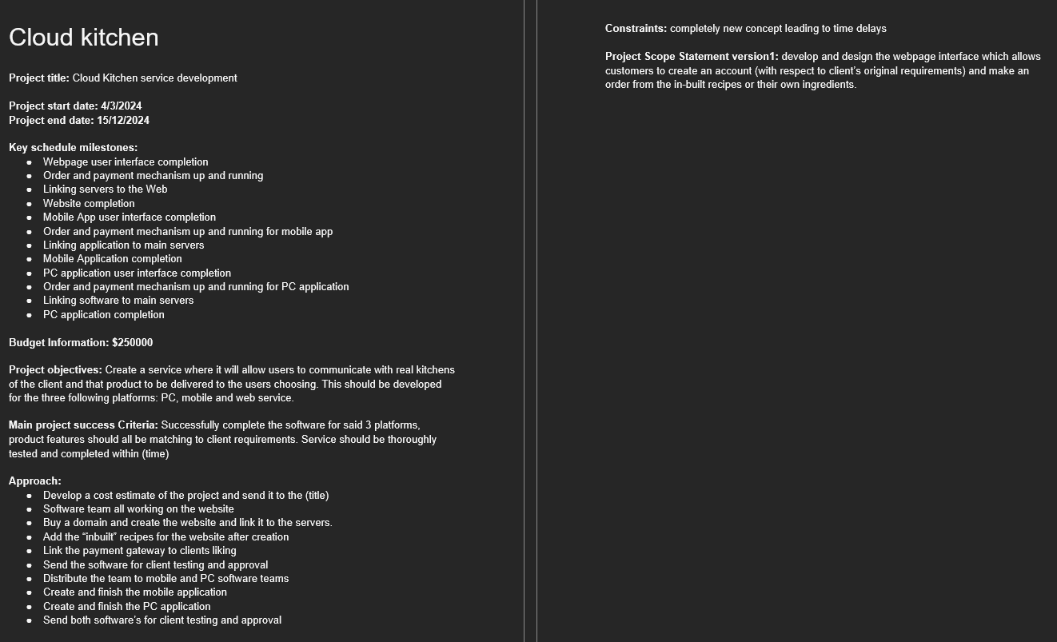
Cloud kitchen
This is the charter document of the cloud kitchen finalized
It contains the start and end date of the project and the key schedule milestones
The document highlights the steps on approaching this project.

Slide 5
C&D Requirements
………………………………………………………………………………………………………

Slide 6
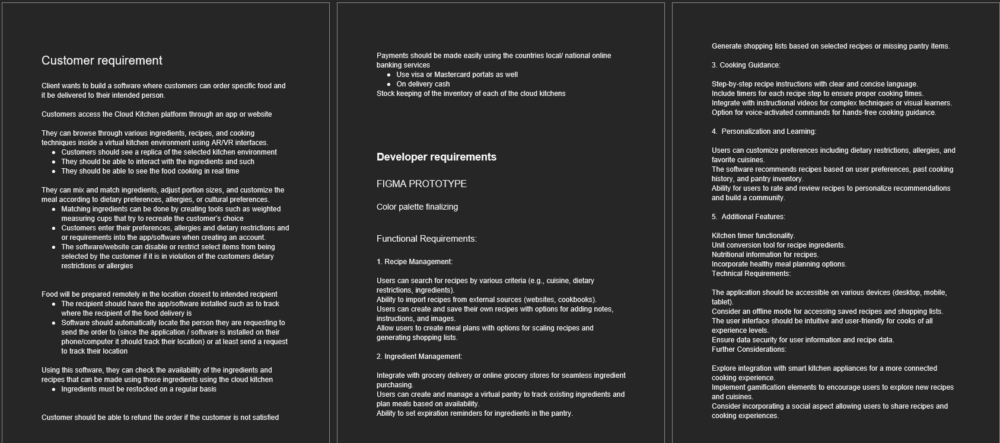
C & D Requirements

Slide 7
Success criteria
These are the goals we set to achieve and the rubric we have made to criticize the progress.

Slide 8
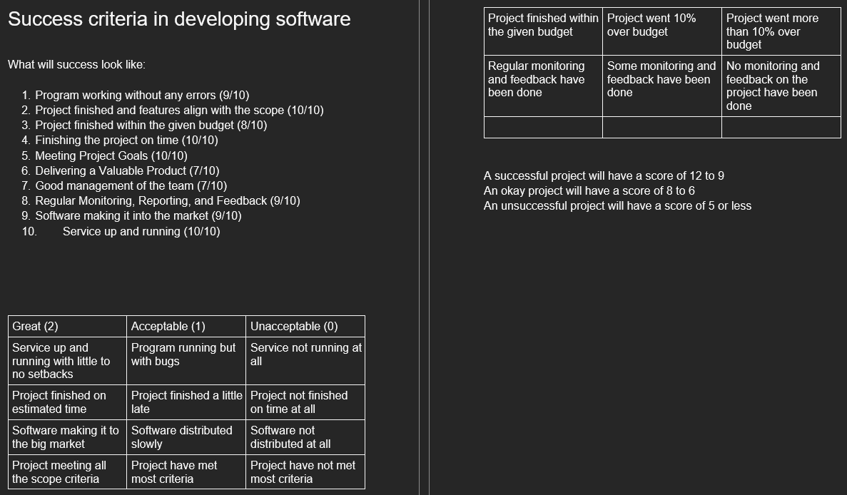
Success criteria

Slide 9
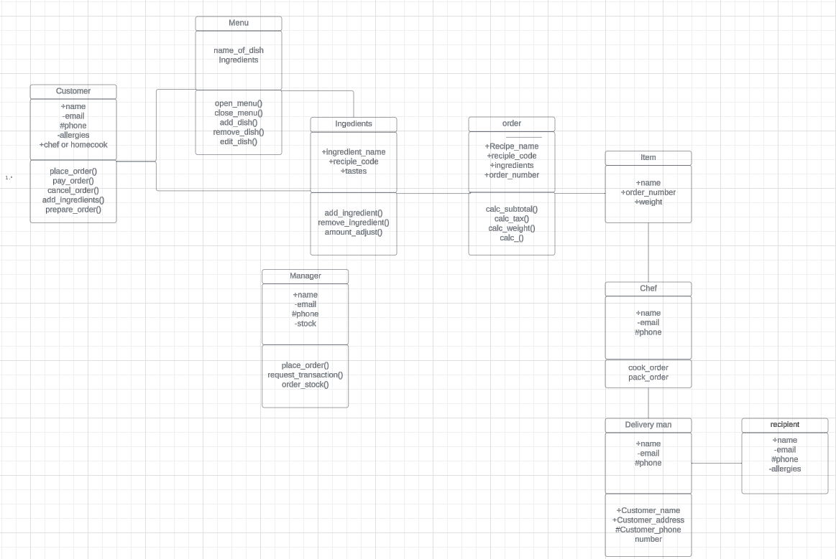
Class diagram
This describes the structure of the whole operation by showing the related classes, their attributes, operations (or methods), and the relationships among objects.

Slide 10
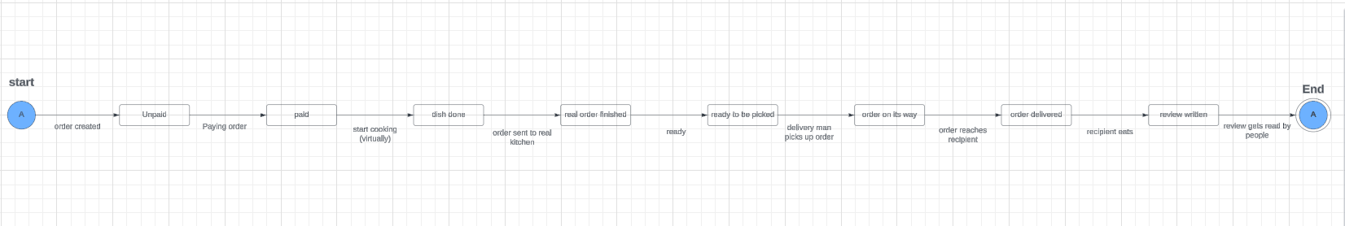
State Diagram

Slide 11
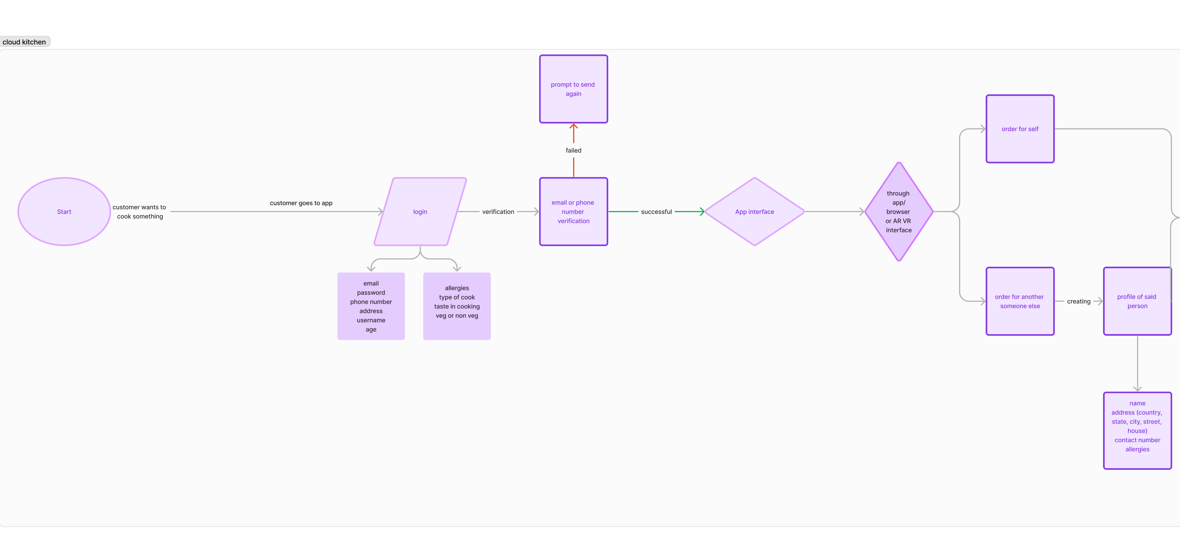
Flow Chart

Slide 12
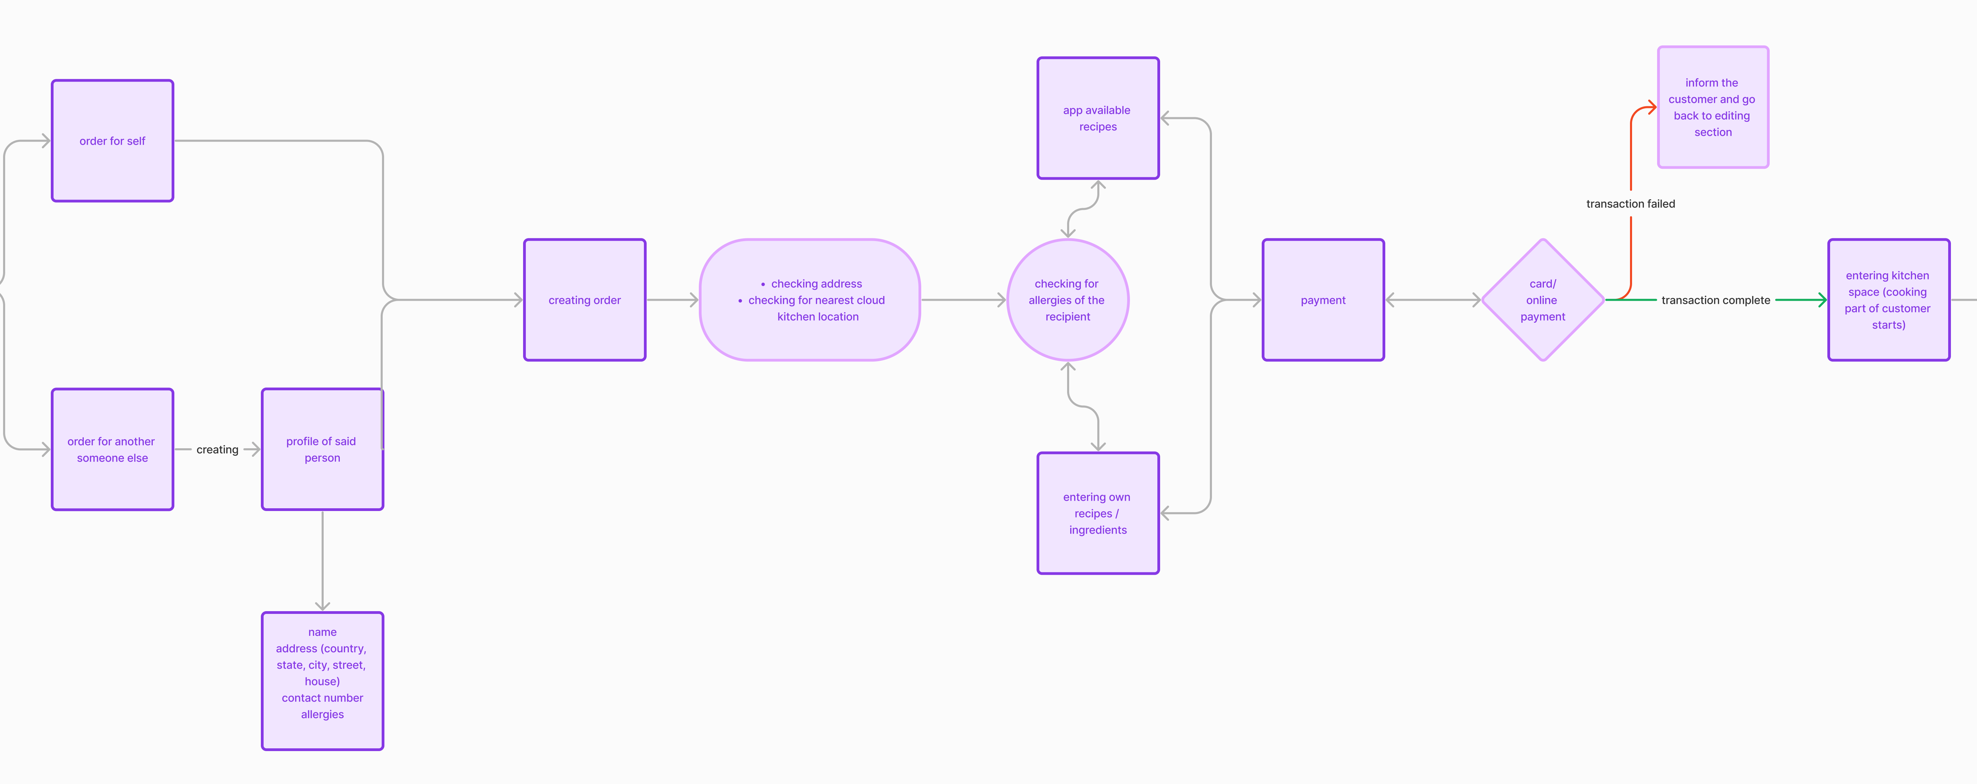
Flow Chart

Slide 13
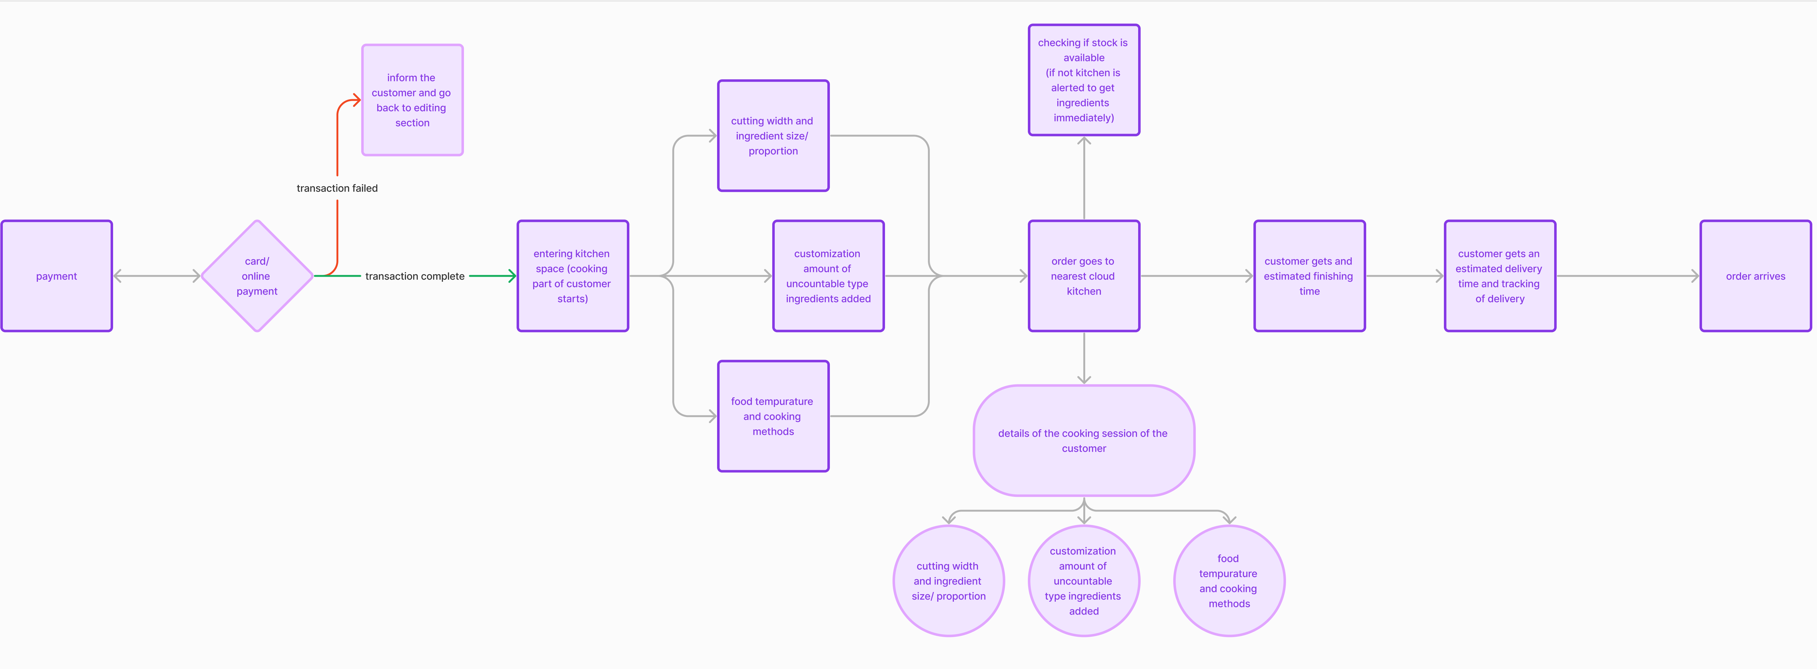
Flow Chart

Slide 14
Thank you
by: Firas, Numair, Rafhaan, Sheeba, mazeen, Nishaahu, ahlam, Thaufeeq
Students of Advanced certificate in IT (Polytechnic)

